Slide 1
Lecture 4 – Probability Distributions
OPIM 5603 – Statistics in Business Analytics

Slide 2
Outline
Random variables
Discrete distributions
Continuous distributions
Linear combinations of random variables and Covariance
Chebychev’s rule

Slide 3
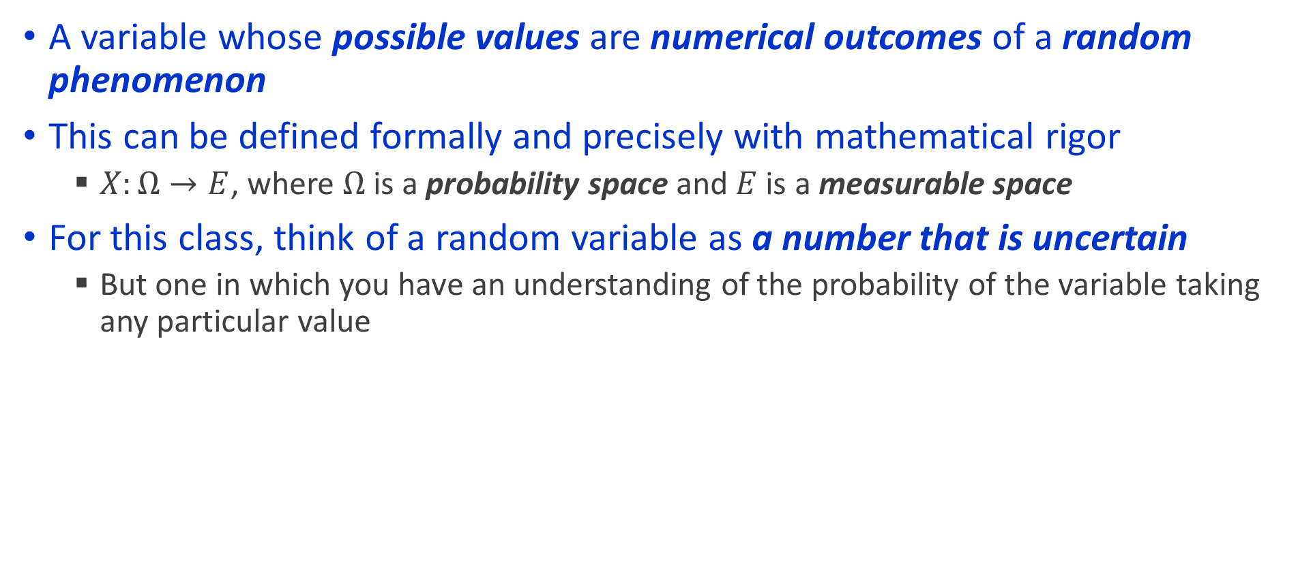
Random Variables
A variable whose possible values are numerical outcomes of a random phenomenon
This can be defined formally and precisely with mathematical rigor
$X:Ω→E$, where $Ω$ is a probability space and $E$ is a measurable space
For this class, think of a random variable as a number that is uncertain
But one in which you have an understanding of the probability of the variable taking any particular value

Slide 4
What is an example of a random variable
The amount of time a machine is idle for
The salary of a graduate from MSBAPM
The number of heads that face up when you toss 10 coins
There are two main types
Discrete variables produce outcomes that come from a counting process (e.g. number of classes you are taking).
Continuous variables produce outcomes that come from a measurement (e.g. your annual salary, or your weight).

Slide 5
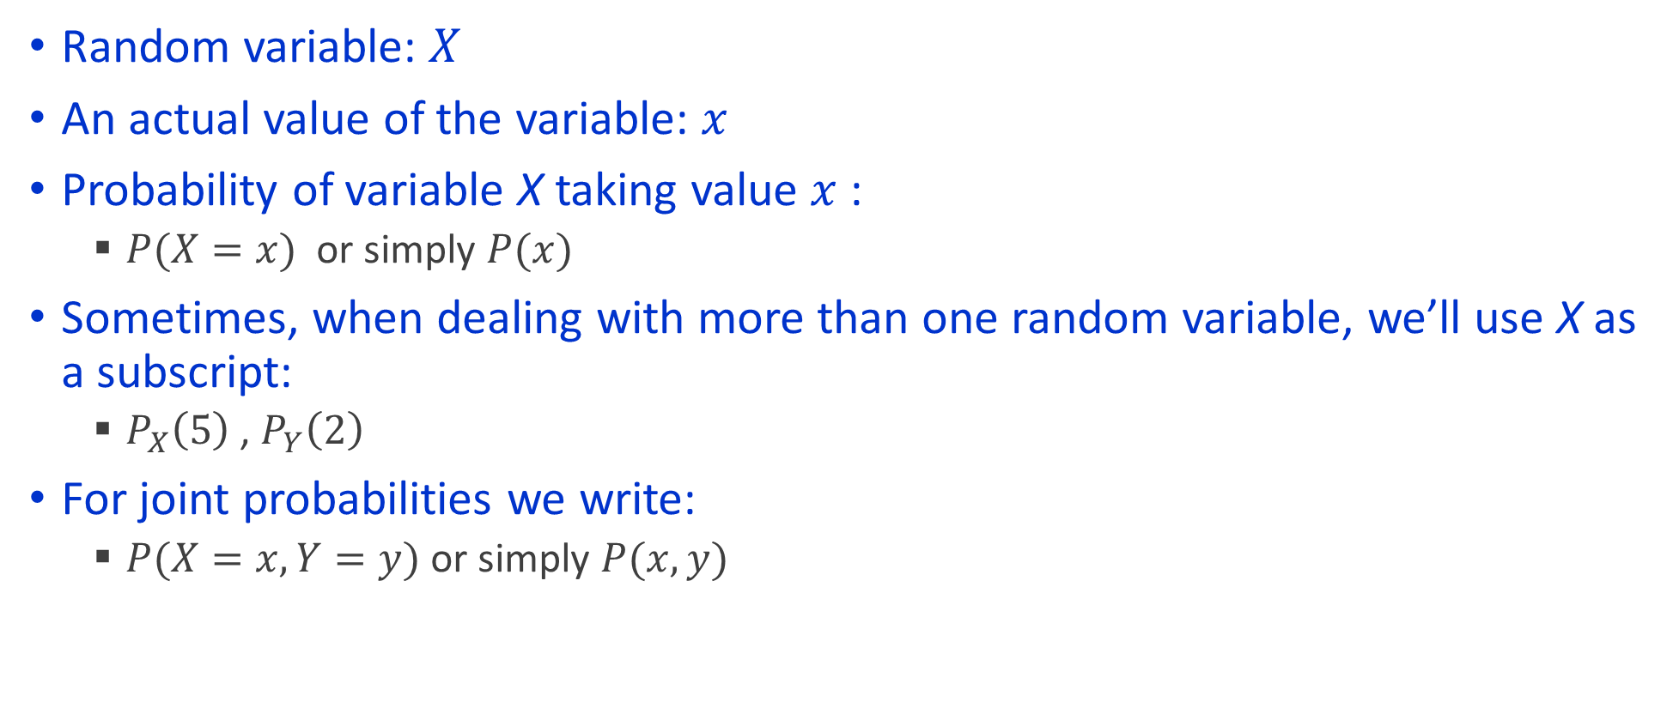
Some notation is required
Random variable: $X$
An actual value of the variable: $x$
Probability of variable X taking value $x$:
$P(X=x)$ or simply $P(x)$
Sometimes, when dealing with more than one random variable, we’ll use X as a subscript:
$P_{X}\left(5\right)$ , $P_{Y}\left(2\right)$
For joint probabilities we write:
$P(X=x, Y=y)$ or simply $P(x, y)$

Slide 6
Probability Distribution
Every random variable has a probability distribution which defines how likely the variable is to take a value, or a range of values
The structure of the distribution depends on whether the distribution is discrete or continuous
Discrete variables produce outcomes that come from a counting process (e.g. number of classes you are taking).
Continuous variables produce outcomes that come from a measurement (e.g. your annual salary, or your weight).
Discrete
Variable
Continuous
Variable

Slide 7
Discrete Distribution
A probability mass function (PMF) for a discrete random variable is a mutually exclusive and collectively exhaustive list of all possible numerical outcomes for that variable and a probability of occurrence associated with each outcome.
Interruptions Per Day In Computer Network (X) | Probability (P(X=x))
0 | 0.35
1 | 0.25
2 | 0.20
3 | 0.10
4 | 0.05
5 | 0.05

Slide 8

Properties of a PMF
There are properties that are satisfies by every probability mass function
$p\left(x\right)≥0$ for every real number $x$
$\sum_{x=−∞}^{x=∞}{p\left(x\right)=1}$

Slide 9

Cumulative Distribution Function
A cumulative distribution function (CDF) (or simply distribution function) is a function that associates, for each x, the probability that X is less than or equal to x
Typically denoted by $F(x)$ which indicates $P(X≤x)$
Example. Let X be the sum of the dots when you throw two dice
x | Outcomes | P(x) | F(x)
0 | 0 | 0.00 | 0.00
1 | 0 | 0.00 | 0.00
2 | 1 | 0.03 | 0.03
3 | 2 | 0.06 | 0.08
4 | 3 | 0.08 | 0.17
5 | 4 | 0.11 | 0.28
6 | 5 | 0.14 | 0.42
7 | 6 | 0.17 | 0.58
8 | 5 | 0.14 | 0.72
9 | 4 | 0.11 | 0.83
10 | 3 | 0.08 | 0.92
11 | 2 | 0.06 | 0.97
12 | 1 | 0.03 | 1.00
13 | 0 | 0.00 | 1.00
Total | 36 | 1

Slide 10
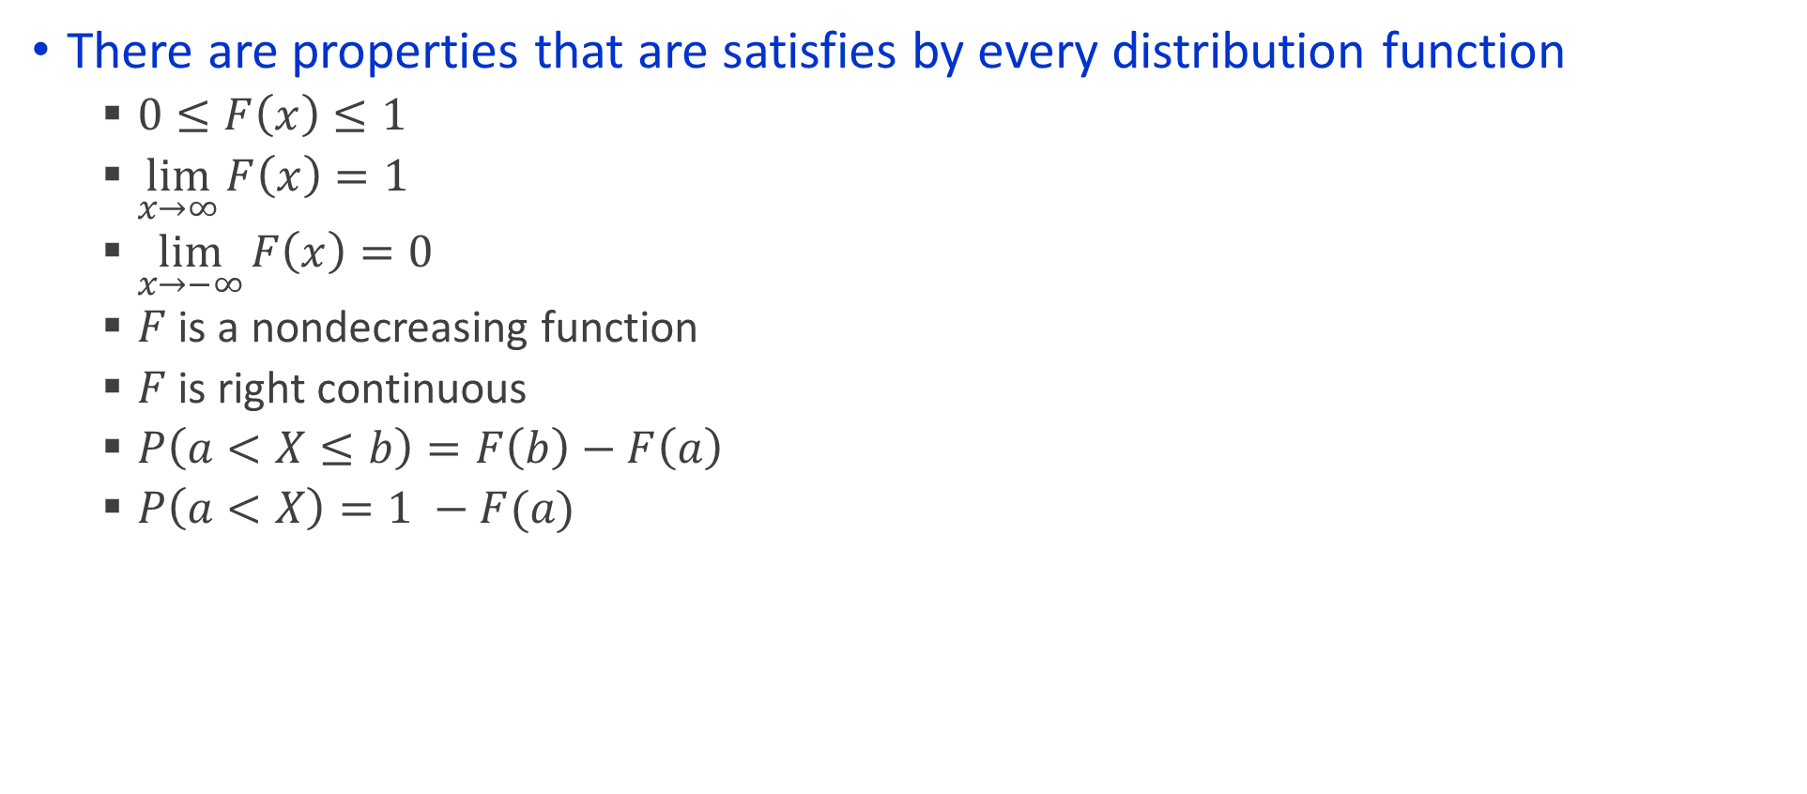
Properties of a distribution function
There are properties that are satisfies by every distribution function
$0≤F\left(x\right)≤1$
$\lim_{x→∞}{F\left(x\right)=1}$
$\lim_{x→−∞}{F\left(x\right)=0}$
$F$ is a nondecreasing function
$F$ is right continuous
$P\left(a<X≤b\right)=F\left(b\right)−F\left(a\right)$
$P\left(a<X\right)=1 −F(a)$

Slide 11
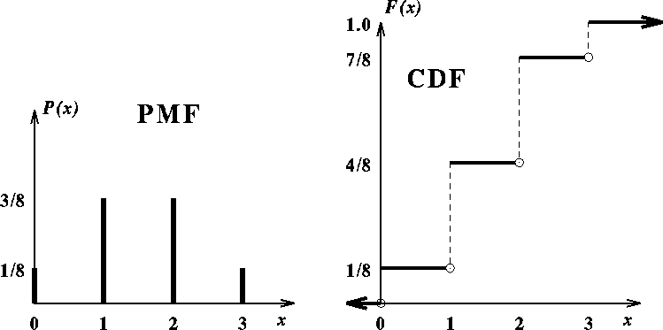
Depiction of PMF and CDF
Let X be the number of months in the first three months of next year that your stock portfolio increases in worth

Slide 12
Expected value of a discrete random variable
Expected Value (or mean) of a discrete variable (Weighted Average)
Interruptions Per Day In Computer Network (x_{i}) | Probability P(X = x_{i}) | x_{i}P(X = x_{i})
0 | 0.35 | (0)(0.35) = 0.00
1 | 0.25 | (1)(0.25) = 0.25
2 | 0.20 | (2)(0.20) = 0.40
3 | 0.10 | (3)(0.10) = 0.30
4 | 0.05 | (4)(0.05) = 0.20
5 | 0.05 | (5)(0.05) = 0.25
 | 1.00 | μ = E(X) = 1.40

Slide 13
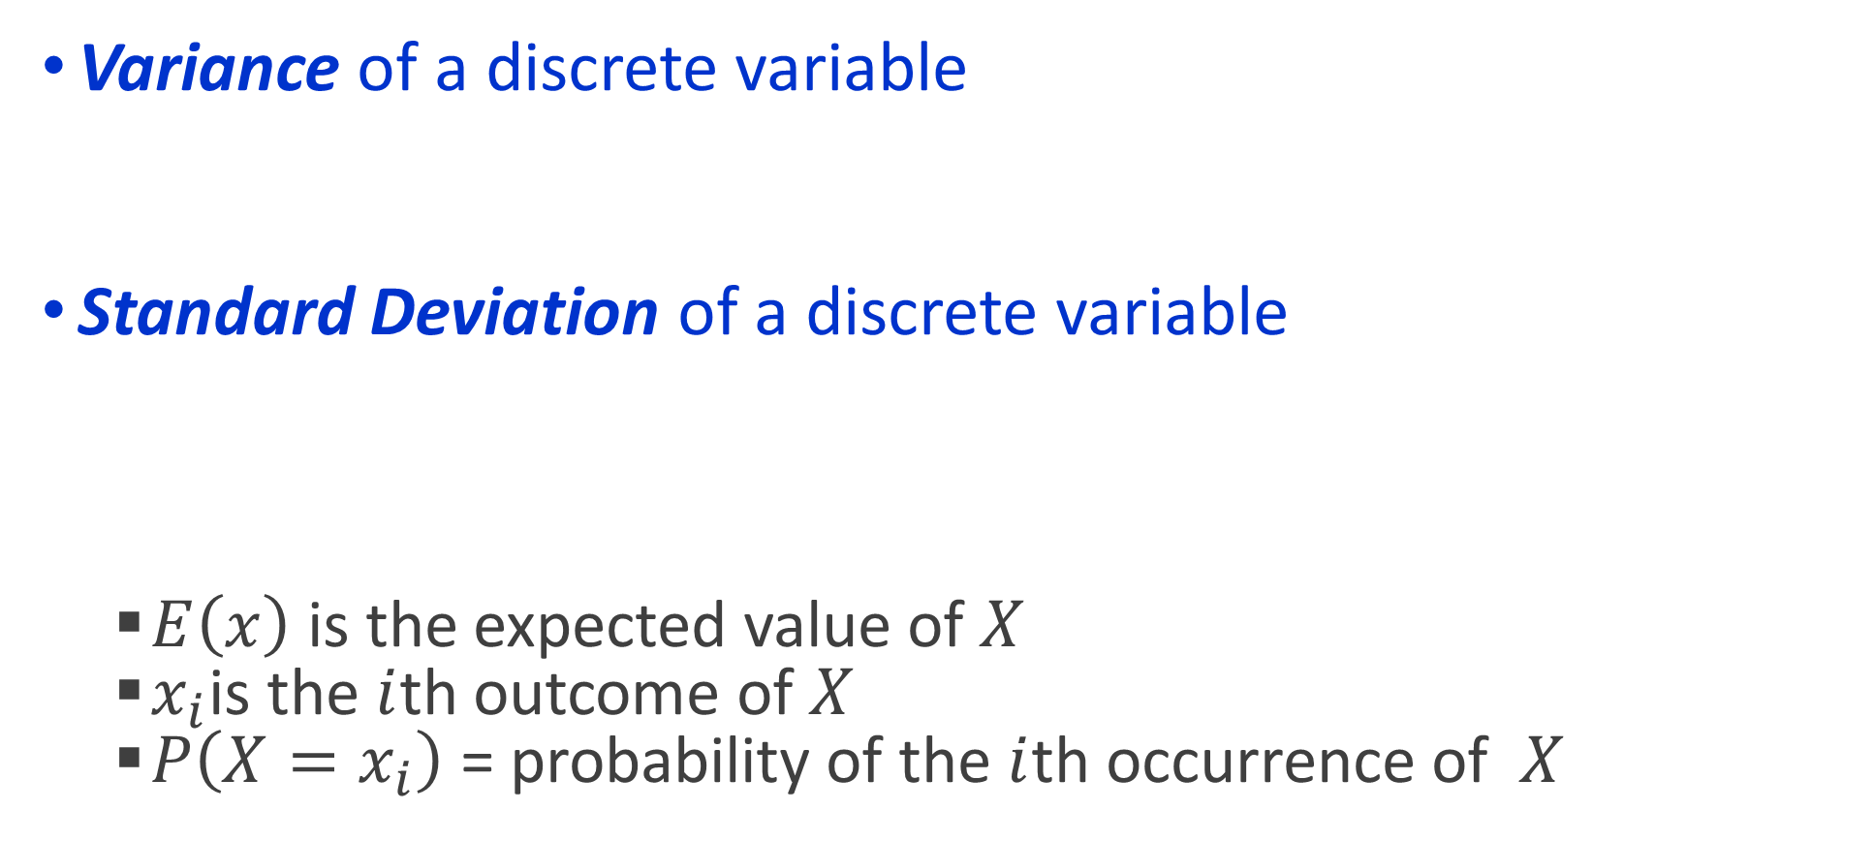
Measures of dispersion of a discrete random variable
Variance of a discrete variable
Standard Deviation of a discrete variable
$E\left(x\right)$ is the expected value of $X$
$x_{i}$is the $i$th outcome of $X$
$P\left(X=x_{i}\right)$ = probability of the $i$th occurrence of $X$

Slide 14
Example calculation
Interruptions Per Day In Computer Network (x_{i}) | Probability P(X = x_{i}) | [x_{i} – E(X)]² | [x_{i} – E(X)]²P(X = x_{i})
0 | 0.35 | (0 – 1.4)² = 1.96 | (1.96)(0.35) = 0.686
1 | 0.25 | (1 – 1.4)² = 0.16 | (0.16)(0.25) = 0.040
2 | 0.20 | (2 – 1.4)² = 0.36 | (0.36)(0.20) = 0.072
3 | 0.10 | (3 – 1.4)² = 2.56 | (2.56)(0.10) = 0.256
4 | 0.05 | (4 – 1.4)² = 6.76 | (6.76)(0.05) = 0.338
5 | 0.05 | (5 – 1.4)² = 12.96 | (12.96)(0.05) = 0.648
 |  |  | σ² = 2.04, σ = 1.4283

Slide 15
Reading Data into R
Let’s calculate the mean, variance, and standard deviation of the random variable from the previous slide

Slide 16
Probability distribution families
Due to the commonality of certain probability distributions, mathematicians and statisticians have defined and studied families of distributions
This allows practitioners to easily sample or calculate central tendency and measures of dispersion
This also allows for easily modelling a variety of situations
We may see more throughout the semester, but two common discrete distributions are the binomial distribution and the Poisson distribution
Probability distributions will be used to describe, model, and approximate real-life phenomenon
“All models are wrong, but some are useful” – George Box

Slide 17
Binomial Distribution
A fixed number of observations, n.
e.g., 15 tosses of a coin; ten light bulbs taken from a warehouse.
Each observation is classified into one of two mutually exclusive & collectively exhaustive categories.
e.g., head or tail in each toss of a coin; defective or not defective light bulb.
The probability of being classified as the event of interest, π, is constant from observation to observation.
Probability of getting a tail is the same each time we toss the coin.
Since the two categories are mutually exclusive and collectively exhaustive, when the probability of the event of interest is π, the probability of the event of interest not occurring is 1 – π.
The value of any observation is independent of the value of any other observation.

Slide 18
Business applications
A manufacturing plant labels items as either defective or acceptable.
A firm bidding for contracts will either get a contract or not.
A marketing research firm receives survey responses of “yes I will buy” or “no I will not.”
New job applicants either accept an offer or reject it.

Slide 19
Counting techniques for a binomial random variable
Suppose the event of interest is obtaining heads on the toss of a fair coin. You are to toss the coin three times. In how many ways can you get two heads?
Possible ways: HHT, HTH, THH, so there are three ways you can getting two heads.
This situation is fairly simple. We need to be able to count the number of ways for more complicated situations
The number of combinations of selecting X objects out of n objects is

Slide 20
Binomial Distribution Function
P(X=x|n,π) = probability that X = x events of interest, given n and π
x = number of “events of interest” in sample,
(x = 0, 1, 2, ..., n)
n = sample size (number of trials or observations)
π = probability of “event of interest”
1 – π = probability of not having an event of interest
n
!
P(X=x |n,π)
=
x
n
−
x
π
(1-π)
x!
(
−
)
n
x
!
Example: Flip a coin four times, let x = # heads:
n = 4
π = 0.5
1 - π = (1 - 0.5) = 0.5
X = 0, 1, 2, 3, 4

Slide 21
Binomial example
Suppose the probability of an invoice payment being late is 0.10. What is the probability of 1 late invoice payment in a group of 4 invoices?
x = 1, n = 4, and π = 0.10

Slide 22
Binomial example
Suppose the probability of purchasing a defective computer is 0.02. What is the probability of purchasing 2 defective computers in a group of 10?
x = 2, n = 10, and π = 0.02

Slide 23
The shape of the binomial distribution
The shape of the binomial distribution depends on the values of π and n.
P(X=x|5, 0.1)
.6
.4
.2
Here, n = 5 and π = 0.1.
0
0
1
2
3
4
5
x
P(X=x|5, 0.5)
.6
.4
Here, n = 5 and π = 0.5.
.2
0
0
1
2
3
4
5
x

Slide 24
Binomial characteristics
Mean:
Variance and Standard Deviation:
Where n = sample size
π = probability of the event of interest for any trial
(1 – π) = probability of no event of interest for any trial

Slide 25
Binomial characteristics
Here, n = 5 and π = 0.1.
P(X=x|5, 0.1)
.6
.4
.2
0
0
1
2
3
4
5
x
Here, n = 5 and π = 0.5.
P(X=x|5, 0.5)
.6
.4
.2
0
0
1
2
3
4
5
x

Slide 26
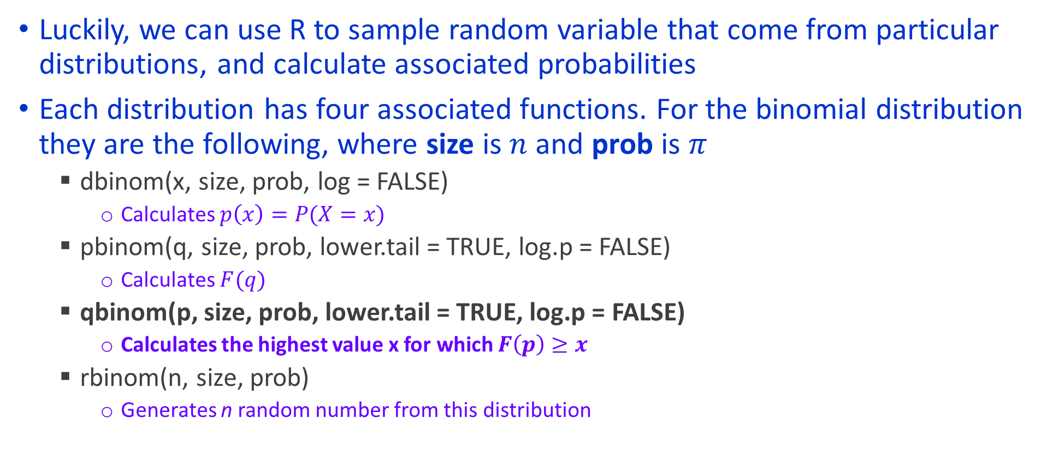
Probability Distribution in R
Luckily, we can use R to sample random variable that come from particular distributions, and calculate associated probabilities
Each distribution has four associated functions. For the binomial distribution they are the following, where size is $n$ and prob is $π$
dbinom(x, size, prob, log = FALSE)
Calculates $p\left(x\right)=P(X=x)$
pbinom(q, size, prob, lower.tail = TRUE, log.p = FALSE)
Calculates $F(q)$
qbinom(p, size, prob, lower.tail = TRUE, log.p = FALSE)
Calculates the highest value x for which $F\left(p\right)≥x$
rbinom(n, size, prob)
Generates n random number from this distribution

Slide 27
Example
Corporation X is buying 150 computers from DELL. It is known that the motherboard used in the computers have probability 0.12 of having a certain defect
What is the probability that 10 computers will have the defect?
What is the probability that no more than 25 computers will have the defect?
What is the probability that fewer than 25 but at least 20 computers will have the defect?
How many computers does Corporation X expect to have this defect?
What is the standard deviation of the number of computers that have this defect?
Corporation X is reconsidering their decision to purchase the computers. They only want to make the purchase if the probability of having more than 22 computers with the defect is less than 0.2. Will the purchase be made?
Suppose that you are in charge of purchasing the computers, and you want to assure the president of Corporation X that this is a good purchase. Your goal is to tell her “I am at least 90% sure that there will be at most K defective motherboards.” Of course, the lower K is, the better. What is the lowest value of K that you can make this claim for?

Slide 28

Plotting PDF and CDF
Plot the PDF and CDF of a binomial random variable with $n=20$ and $π=0.3$

Slide 29
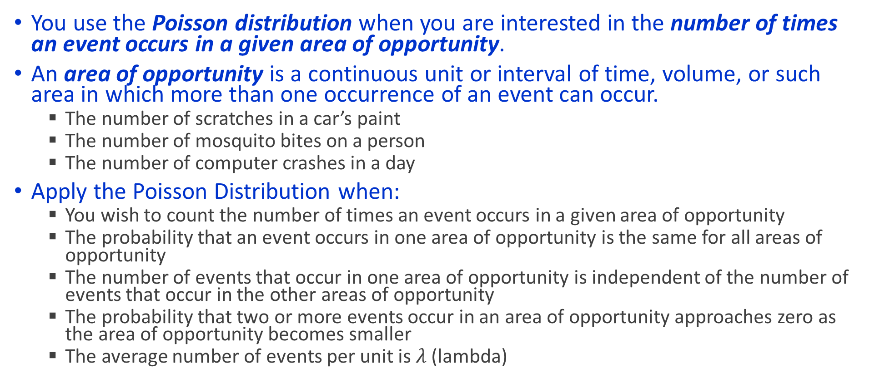
Poisson random variables
You use the Poisson distribution when you are interested in the number of times an event occurs in a given area of opportunity.
An area of opportunity is a continuous unit or interval of time, volume, or such area in which more than one occurrence of an event can occur.
The number of scratches in a car’s paint
The number of mosquito bites on a person
The number of computer crashes in a day
Apply the Poisson Distribution when:
You wish to count the number of times an event occurs in a given area of opportunity
The probability that an event occurs in one area of opportunity is the same for all areas of opportunity
The number of events that occur in one area of opportunity is independent of the number of events that occur in the other areas of opportunity
The probability that two or more events occur in an area of opportunity approaches zero as the area of opportunity becomes smaller
The average number of events per unit is $λ$ (lambda)

Slide 30

PMF for Poisson Distribution
Where:
$λ$ is the expected number of events
$e$ is the base of the natural logarithm
$x$ is the number of events

Slide 31
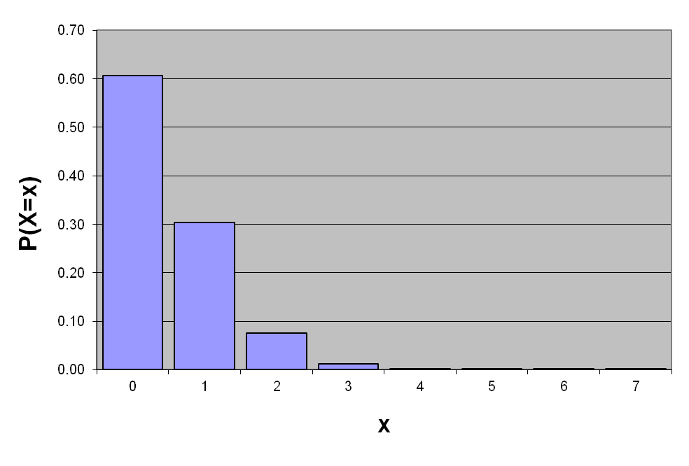
Poisson distribution characteristics
Mean
Variance
Graphically:
λ = 0.50
X | λ = 0.50
0 1 2 3 4 5 6 7 | 0.6065 0.3033 0.0758 0.0126 0.0016 0.0002 0.0000 0.0000
P(X = 2 | λ=0.50) = 0.0758

Slide 32
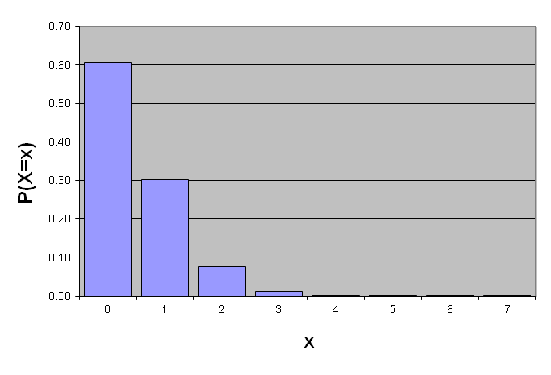
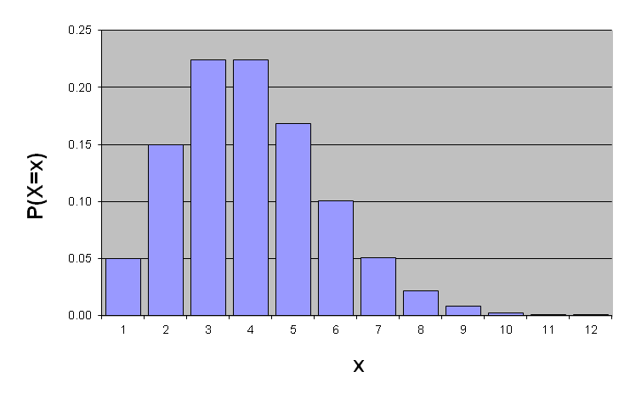
Shape of a Poisson Distribution
The shape of the Poisson Distribution depends on the parameter λ :
λ = 0.50
λ = 3.00

Slide 33
The Poisson Distribution in R
dpois(x, lambda, log = FALSE)
ppois(q, lambda, lower.tail = TRUE, log.p = FALSE)
qpois(p, lambda, lower.tail = TRUE, log.p = FALSE)
rpois(n, lambda)

Slide 34
Example
The IT department at Corporation X maintains the website for the company. Past experience indicates that during working hours, the average time between successive complaints on their website is 20 minutes. If we model the number of complaints received in given work day as a Poisson distribution:
What is the average number of complaints received in an eight-hour work day?
In an eight-hour work day, what is the probability that the IT department will receive fewer than 20 complaints?
The Friday before each holiday, the IT department responds to complaints only for the first six hours of the day. What is the probability that the IT department will receive fewer than 20 complaints in a six-hour day?

Slide 35
Sampling in R
Often you want to understand the probability of complex events occurring
Joint probabilities, conditional probabilities, etc.
One can do an empirical test
Sample numbers and check the probability of the event in question
This is also called Monte Carlo Simulation
Let’s revisit the question from the previous slide, and solve it via sampling
One can also solve for the approximate probability of complex joint events
Continuing the example from the previous slide, suppose that Corporation X has 325 employees, and that the probability an employee complains about his/her email on any given day is 0.05, independently of any other employee. The head of IT get’s very angry if he has to address a total of 50 or more complaints in a given day.
On a normal work day, what is the probability that the head of IT is very angry?
What is the expected number of complaints?
What is the standard deviation of the number of complaints?

Slide 36
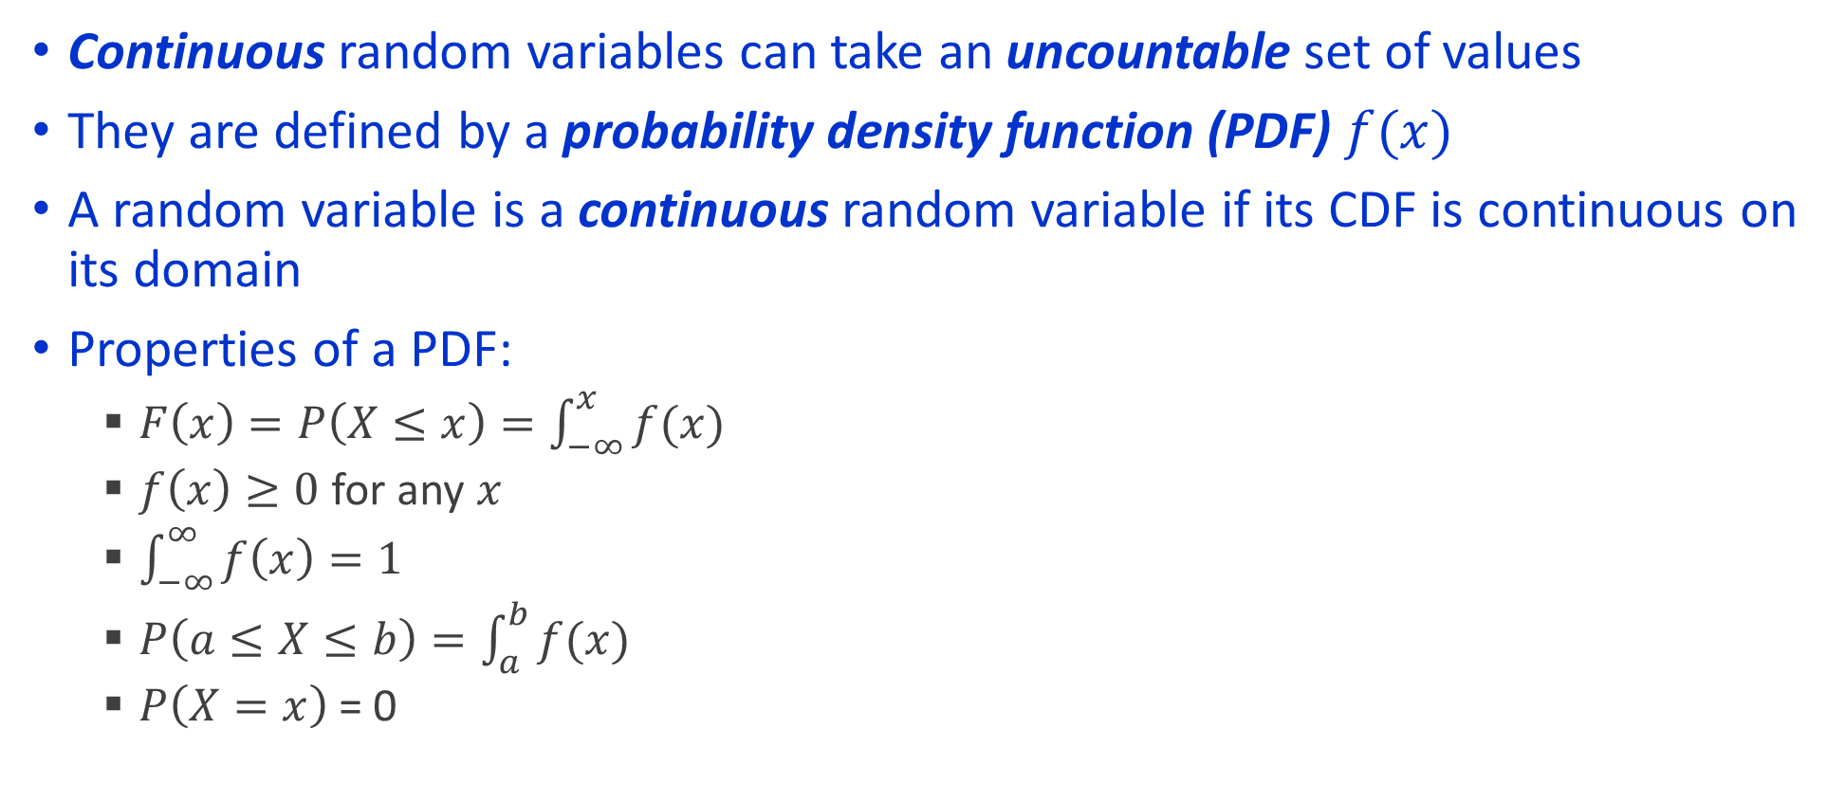
Continuous Random Variables
Continuous random variables can take an uncountable set of values
They are defined by a probability density function (PDF) $f(x)$
A random variable is a continuous random variable if its CDF is continuous on its domain
Properties of a PDF:
$F\left(x\right)=P\left(X≤x\right)=\int_{−∞}^{x}{f(x)}$
$f\left(x\right)≥0$ for any $x$
$\int_{−∞}^{∞}{f\left(x\right)=1}$
$P\left(a≤X≤b\right)=\int_{a}^{b}{f(x)}$
$P\left(X=x\right)$ = 0

Slide 37
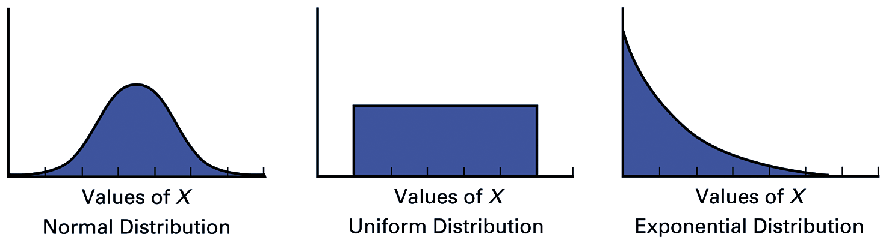
Common Continuous Distributions
Symmetrical
Bell-shaped
Ranges from
negative to
positive infinity
Symmetrical
Every value between
the smallest & largest
is equally likely
Right skewed
Mean > Median
Ranges from
zero to
positive infinity

Slide 38
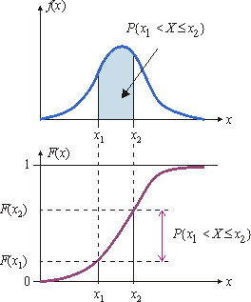
Probabilities are areas for continuous distributions

Slide 39
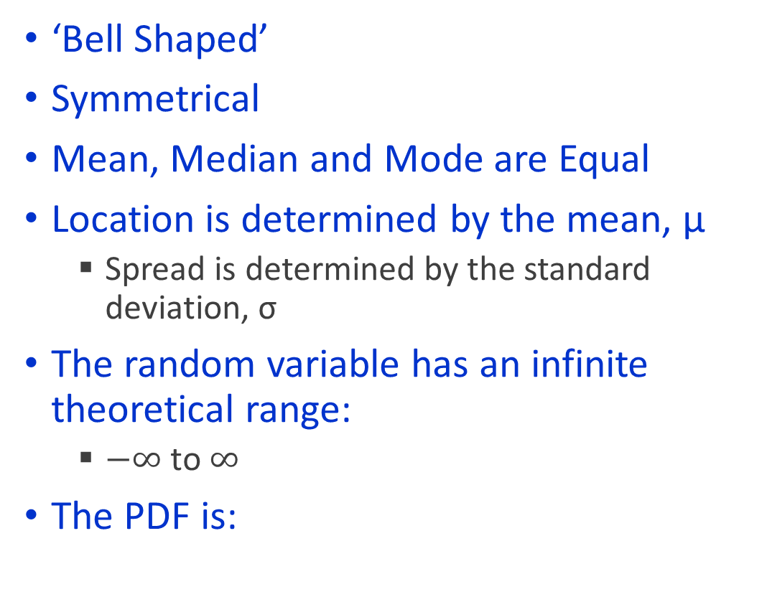
The Normal Distribution
‘Bell Shaped’
Symmetrical
Mean, Median and Mode are Equal
Location is determined by the mean, μ
Spread is determined by the standard deviation, σ
The random variable has an infinite theoretical range:
$−∞$ to $∞$
The PDF is:
f(X)
σ
X
μ
Mean
= Median
= Mode

Slide 40
Normal Distribution Myths
Normal implies that the distribution is bell-shaped and has a symmetric distribution, with mean = median = mode
However:
Bell-shaped data does not imply normal distribution
Symmetric data does not imply normal distribution
Mean = median does not imply normal distribution
Even having the above three properties together do not imply normal distribution
The best bet is having those properties and Kurtosis approximately equal to 3
Can do specific statistical test for “normality” – later

Slide 41
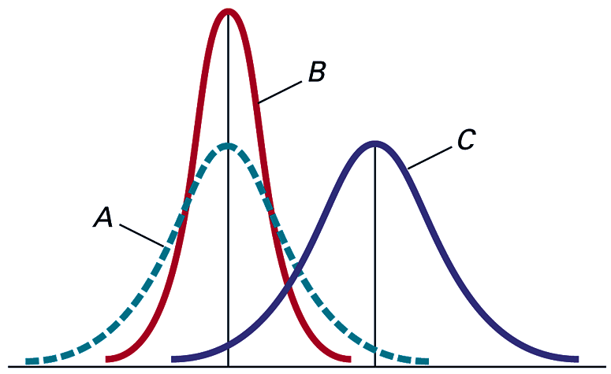
Parameters of the Normal Distribution
By varying the parameters μ and σ, we obtain different normal distributions
A and B have the same mean but different standard deviations.
B and C have different means and different standard deviations.

Slide 42
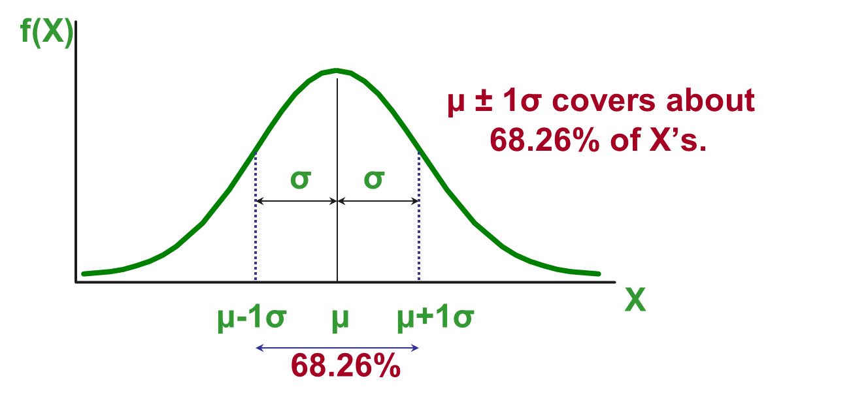
Properties of Normal Distributions

Slide 43
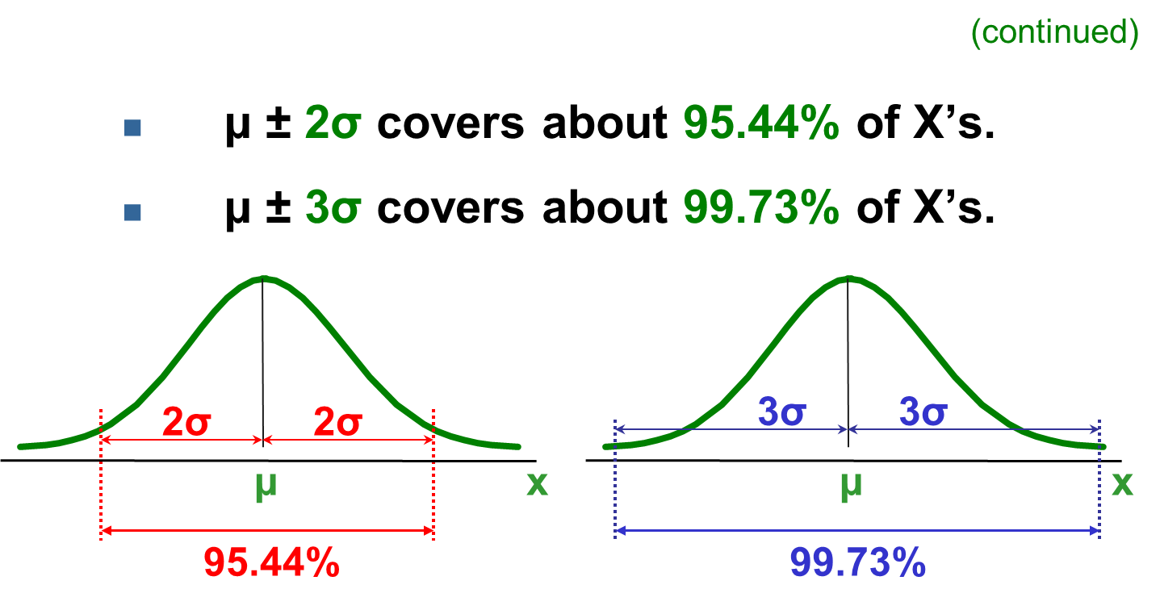
Properties of Normal Distributions

Slide 44
When to use Normal Random Variables?
A lot of times!
We will see the central limit theorem next class. There is theoretical reason to use the normal distribution to model a lot of situations
Calculating probability “By hand” for normal random variables is extremely difficult
Need to take the integral of e to a power
Actually, this is a non-analytical function!
Don’t worry about what the means for now; if you have any questions please ask me outside of class time
In R you can use the same functions as with the previous distributions
dnorm(x, mean = 0, sd = 1, log = FALSE)
pnorm(q, mean = 0, sd = 1, lower.tail = TRUE, log.p = FALSE)
qnorm(p, mean = 0, sd = 1, lower.tail = TRUE, log.p = FALSE)
rnorm(n, mean = 0, sd = 1)

Slide 45
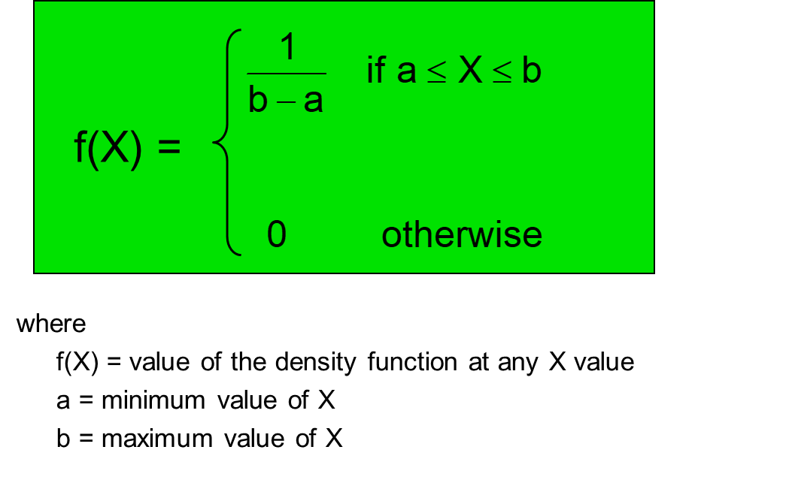
Uniform Random Variables
The uniform distribution is a probability distribution that has equal probabilities for all possible outcomes of the random variable.

Slide 46
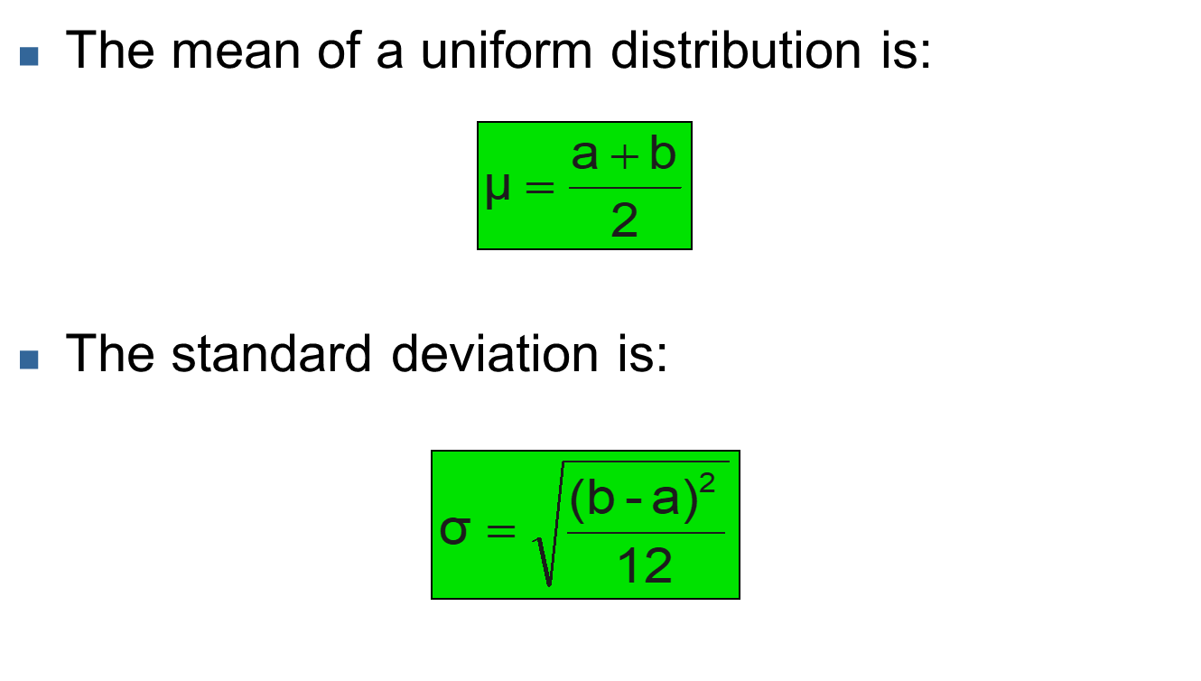
Properties of the Uniform Distribution

Slide 47
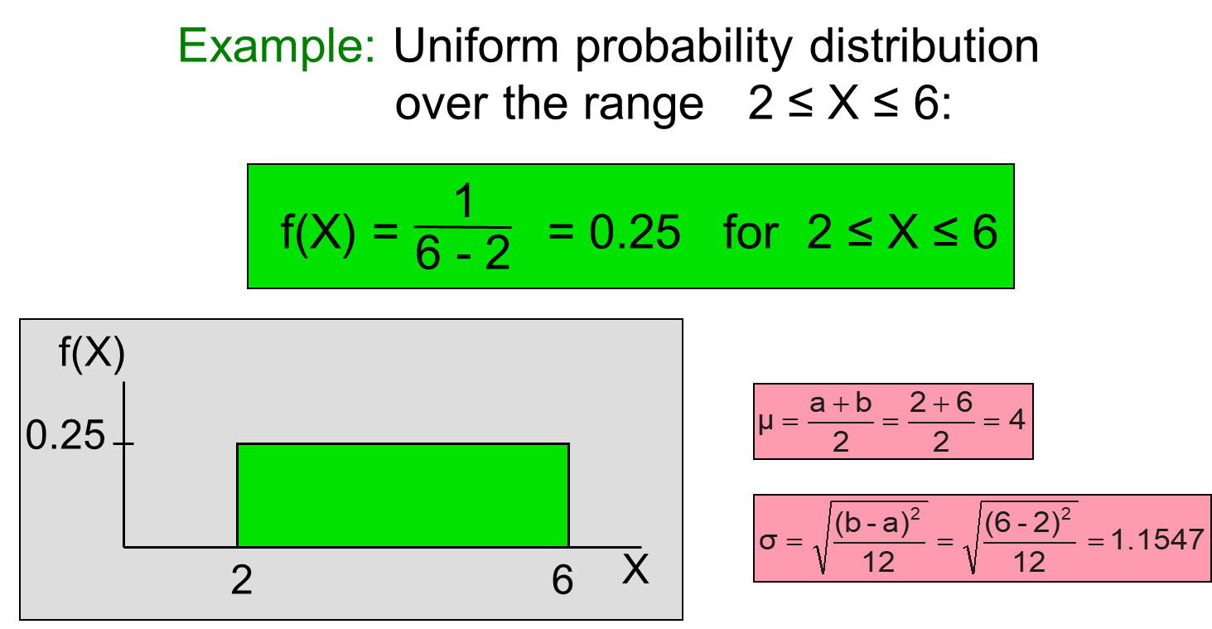
Example

Slide 48
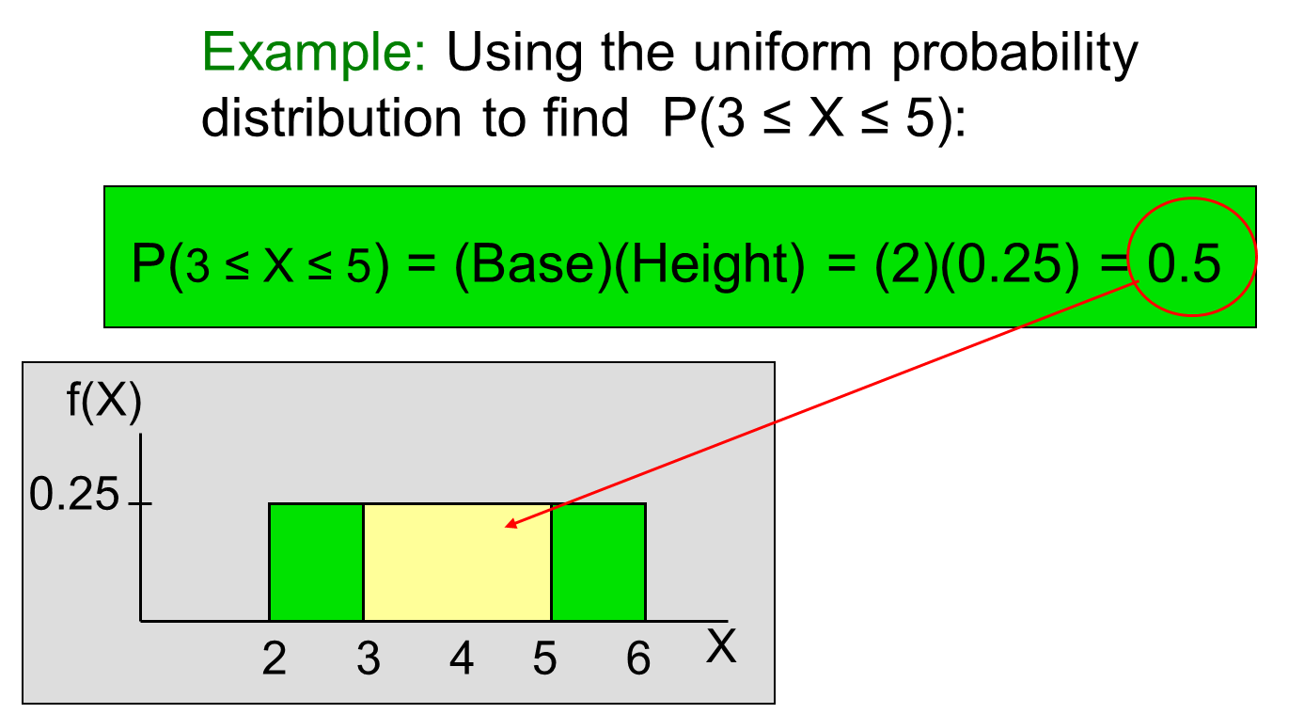
Example

Slide 49
Can also use R
dunif(x, min = 0, max = 1, log = FALSE)
punif(q, min = 0, max = 1, lower.tail = TRUE, log.p = FALSE)
qunif(p, min = 0, max = 1, lower.tail = TRUE, log.p = FALSE)
runif(n, min = 0, max = 1)

Slide 50
Exponential Random Variables
Often used to model the length of time between two occurrences of an event (the time between arrivals).
Examples:
Time between trucks arriving at an unloading dock.
Time between transactions at an ATM Machine.
Time between phone calls to the main operator.
Defined by a single parameter, the mean λ (lambda) rate of arrival per time period:
The expected value is:
The standard deviation is:

Slide 51
Exponential Distribution Example
Customers arrive at the service counter at the rate of 20 per hour. What is the probability that the arrival time between consecutive customers is less than six minutes?
Can use R to calculate:
dexp(x, rate = 1, log = FALSE)
pexp(q, rate = 1, lower.tail = TRUE, log.p = FALSE)
qexp(p, rate = 1, lower.tail = TRUE, log.p = FALSE)
rexp(n, rate = 1)

Slide 52
Portfolio Example
Let X be the return from investment 1, and Y be the return from investment 2
Suppose that the expected return from investment 1 is $50 and that the expected return from investment 2 is $95
Suppose that 40% of your portfolio is in investment 1, and 60% of your portfolio is in investment 2
Suppose that the variance of investment 1 is $43.30 and that the variance for investment 2 is $193.21
Finally, suppose that the covariance of the investments is 8250.
What is the expected return of your portfolio?
What is the variance of your portfolio?

Slide 53
Linear Combinations of Random Variables
For any two random variables X,Y
Furthermore:
What if we want the variance or standard deviation of a linear combination of random variables?
Let’s take a quick trip back to samples

Slide 54
Covariance
Any two numerical variables have a sample covariance defined by:
cov(X,Y) > 0 X and Y tend to move in the same direction.
cov(X,Y) < 0 X and Y tend to move in opposite directions.
cov(X,Y) = 0 X and Y are independent.
The covariance has a major flaw:
It is not possible to determine the relative strength of the relationship from the size of the covariance.

Slide 55
Correlation Coefficient
The coefficient of correlation corrects the issue with covariance, and gives a better measure of the linear relationship
The population coefficient of correlation is referred as ρ.
The sample coefficient of correlation is referred to as r.
Both ρ or r have the following features:
Unit free.
Range between –1 and 1.
The closer to –1, the stronger the negative linear relationship.
The closer to 1, the stronger the positive linear relationship.
The closer to 0, the weaker the linear relationship.

Slide 56
Depiction of correlation coefficient
Y
Y
X
X
r = -1
r = -.6
Y
Y
Y
X
X
X
r = +1
r = +.3
r = 0

Slide 57
Correlation in R
Use mtcars
Plot mpg versus hp
Check correlation, but using the cor function
Check that the covariance, calculated via the function cov, can be used to calculate the correlation by dividing by the product of the individual sample standard deviations

Slide 58
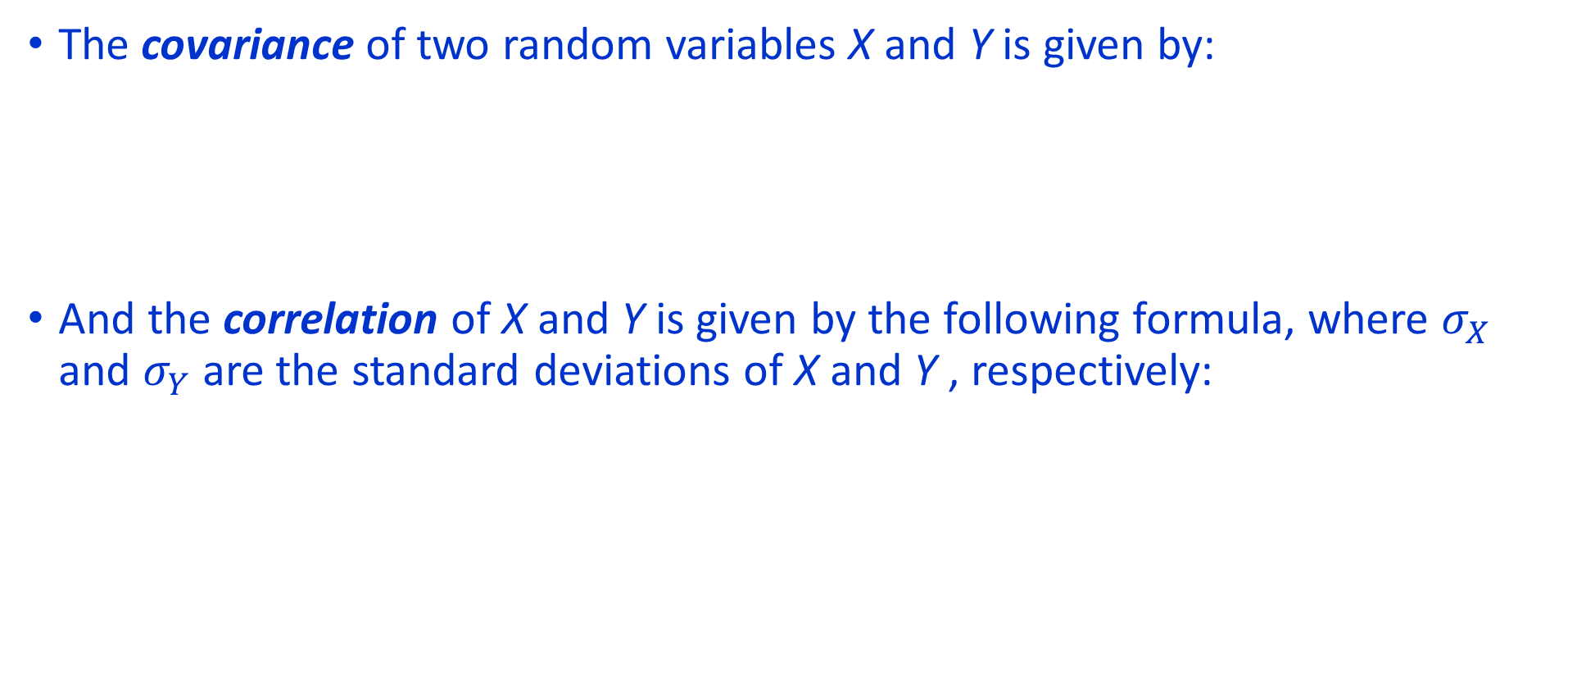
Covariance of Random Variables
The covariance of two random variables X and Y is given by:
And the correlation of X and Y is given by the following formula, where $σ_{X}$ and $σ_{Y}$ are the standard deviations of X and Y , respectively:

Slide 59
Returning to Linear Combinations of Random Variables
Let’s suppose we have two random variables, X and Y

Slide 60
Portfolio Example
Let X be the return from investment 1, and Y be the return from investment 2
Suppose that the expected return from investment 1 is $50 and that the expected return from investment 2 is $95
Suppose that 40% of your portfolio is in investment 1, and 60% of your portfolio is in investment 2
Suppose that the variance of investment 1 is $43.30 and that the variance for investment 2 is $193.21
Finally, suppose that the covariance of the investments is 8250.
What is the expected return of your portfolio?
What is the variance of your portfolio?

Slide 61
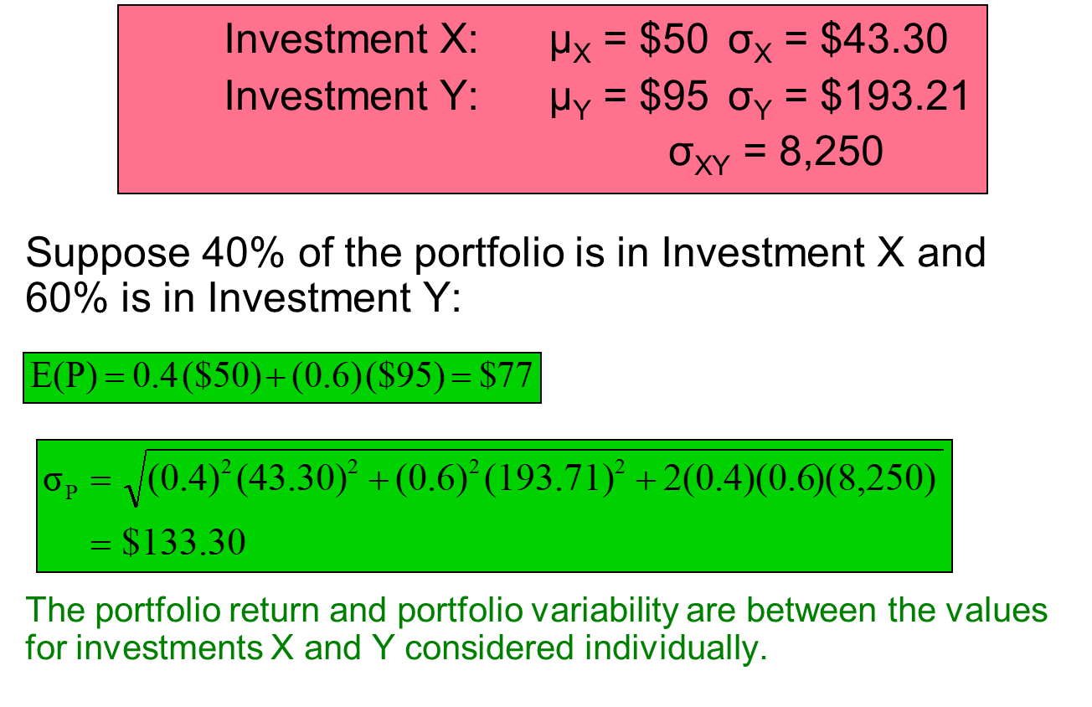
Portfolio Example

Slide 62
Chebyshev’s Rule
This rule applies to all types of probability distributions
Regardless of how the data are distributed, at least (1 - 1/k2) x 100% of the values will fall within k standard deviations of the mean (for k > 1)

